Slide 1

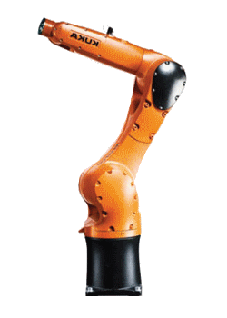
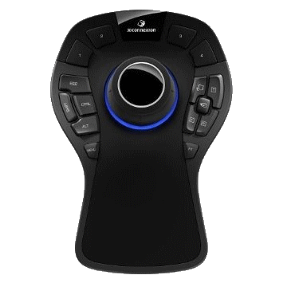
KUKA Mouse 6D
Create your own scenario
Mail: olvier,leger@imerir.com

Slide 2
Characteristics
Program:
Langage: C#
Library: NewtonSoft Json / novalinx kuka / TDX Input
GITHUB: https://github.com/Blackout76/KUKA_scenario_Mouse6D
Tools:
6D mouse : 3D connexion Pro
KUKA KR6 Agilus
Microsoft Visual Studio Community 2015
Works:
4 hours for robot debug
~ 3900 lines of code

Slide 3
Program Organisation
Memory
JSON format
IHM Menu
DATA:
Trajectory
Areas
Scenario
IHM Load
Load scenario
IHM Edit
Add Edit remove
Mouse Engine
Robot
Scenario Engine

Slide 4
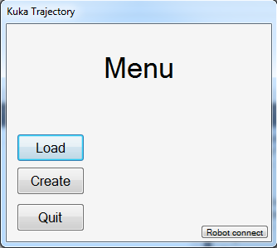
IHM Menu

Slide 5
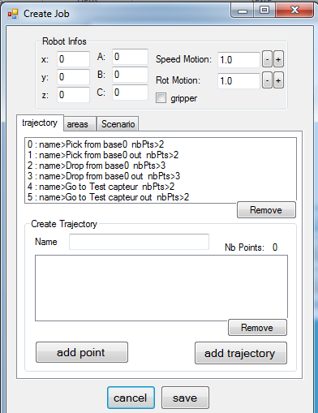
IHM EDIT Trajectory
Robot
infos

Slide 6
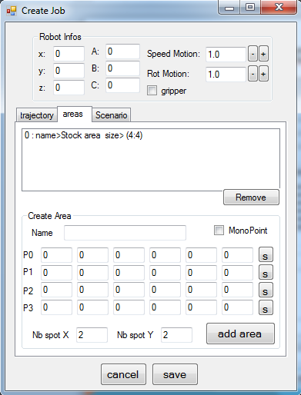
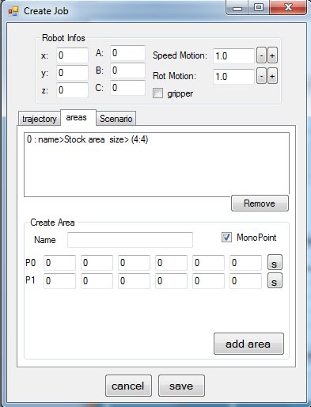
IHM EDIT AREA

Slide 7
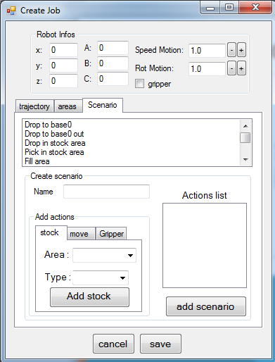
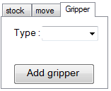
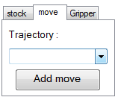
IHM EDIT SCENARIO
Open
close
Trajectory
list
Area
List
Drop
Pick

Slide 8

Questions

